Slide 1
Lessons Learned:
Access Without Support is Not Opportunity
Symposia on Student Success
Cape Town, South Africa
        August 23, 2013
Vincent Tinto
vtinto@syr.edu

Slide 2
Support for Student Success
Learning to Navigate the University
Finding Academic and Social Support
2

Slide 3
Learning to Navigate the University
Orientation
Advising
First-year seminars/University 101
3

Slide 4
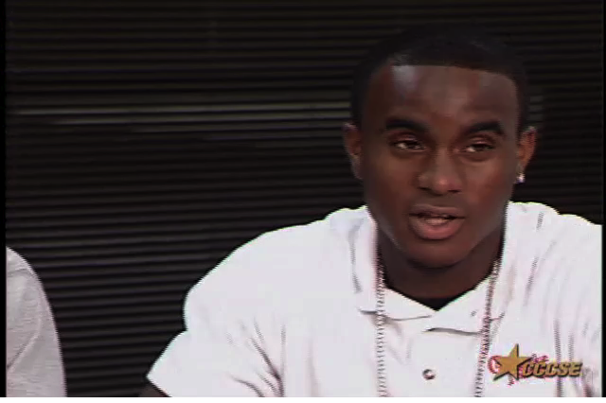
View video clip online:
http://youtu.be/mi-CHNuUaeg
4

Slide 5

View video clip online:
http://youtu.be/5k7pc1NoCUY
5

Slide 6
Finding Academic Support
Academic Support
  Student success course
6

Slide 7
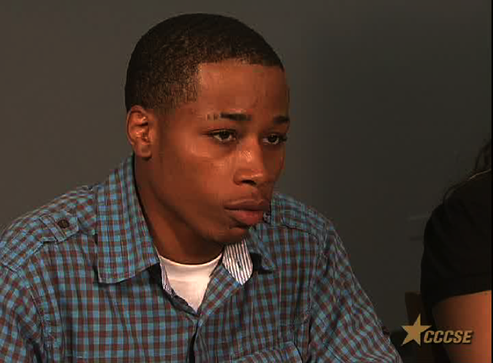
View video clip online:
http://youtu.be/GLdQnv4zv0A
7

Slide 8
Finding Academic Support
Academic Support
  Student success course
  Contextualized academic support
      Supplemental Instruction
      Embedded academic support
      Basic skills learning communities
8

Slide 9
Supplemental Instruction (SI)
Economics
Instructor
Supplemental
Study Groups
A
B
C
D
Tutor A Tutor B Tutor C Tutor D
9

Slide 10
First-Year Learning Communities
English
Sociology
Student Success Course
10

Slide 11
Finding Social Support
  Counselors
  Mentors
  Cohort programs
  First-year learning communities
  Student clubs/organizations
11

Slide 12
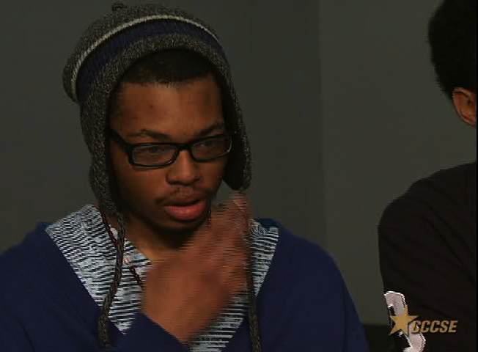
View video clip online:
http://youtu.be/pTS0Gq9Yyrg
12

Slide 13
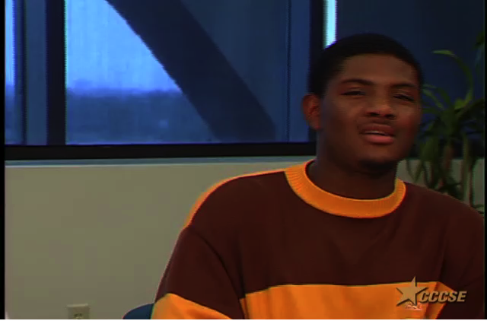
View video clip online:
http://youtu.be/VMlhmG6laQM
13

Slide 14
Learning Communities and Social Support
“In the cluster we knew each other, we were friends, we discussed everything from all the classes. We knew things very, very well because we discussed it all so much. We had discussions about everything… it was like a raft running the rapids of my life.”
14

Slide 15
Knowing When to Provide Support
  Early-warning systems
    Signals Project
    Predictive Analytics
  Peer mentors
    Training and Backup
15

Slide 16
Support for Student Success
Support and student development
throughout the student career: A developmental approach to student success
16

Slide 17
:
Closing Thought
  Effective student support does not arise by chance. It requires intentional, structured, and proactive action that is systematic in nature and coordinated in application.
17

Slide 18
Thank You
Please feel free to contact me if
I can be of assistance.
vtinto@syr.edu
18

