Slide 1

The Quality Enhancement Project
Focus Area 1: Enhancing academics as teachers
Workshop for private higher education institutions

Slide 2


Key statistics for 2011
SA population 51.8 million
No. 15-19 year olds 5.0 million
No. 20-24 year-olds 5.4 million
No. HE students 938 200
20-24 year old participation rate 17%
Black African 14%
White 57%

Slide 3
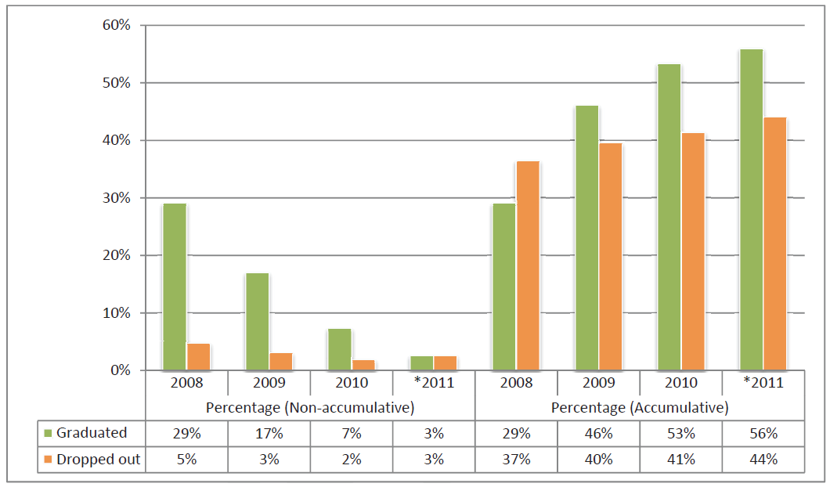
Throughput rates for 3-year degree 2006 student cohort in public HEIs (excluding UNISA)
(VitalStats Public Higher Education 2011, CHE)

Slide 4
National Development Plan 2012
“The data on the quality of university education is disturbing. South African universities are mid-level in terms of knowledge production, with low participation, high attrition rates and insufficient capacity to produce the required levels of skills. They are still characterised by historical inequities and distortions.”

Slide 5
The big question
How does higher education provide meaningful education to an ever increasing, large number of very diverse students that will enable them to succeed in life and employment in a globalised and constantly changing environment with increasingly constrained human and material resources?

Slide 6
Focus of the Quality Enhancement Project
The enhancement of student learning with a view to producing an increased number of graduates with attributes that are personally, professionally and socially valuable.
1. enhanced student learning, leading to an
2. increased number of graduates that have
3. improved graduate attributes
STUDENT SUCCESS

Slide 7
Both institutionally-based and nationally coordinated activities
Institutional enhancement
HE system enhancement

Slide 8
Initial focus areas (2014-2015)
1. Enhancing academics as teachers
2. Enhancing student support and development
3. Enhancing the learning environment
4. Enhancing course and programme enrolment management

Slide 9
Enhancing academics as teachers
The days when universities catered for a small, academically well-prepared cadre of well-off young people are gone. Today’s students are diverse in every way–academic background, culture, language, socio-economic status and even age.
And there are many more students (from 2000 to 2007 there was a 53% increase in the number of tertiary students globally). This makes the quality of university teaching much more important.

Slide 10
Focus area 1
Creating an enabling institutional environment
Teaching
Assessment
Curriculum development

Slide 11
GROUP DISCUSSION
Workload
Does your institution have a workload model for academics?
What is included in it?
Is it applied consistently across the institution?
Who is responsible for allocating work?
What recourse does an academic have if they feel overloaded?
If there is no model, how is work allocated fairly?
Summarise useful ideas and challenges discussed.

Slide 12
Responses- workload models (44 Y, 14 N)
Workload models include:
Hours allocated to face-to-face teaching, including supervision of projects (40)
Administrative activities, such as meetings, committees, QA activities and teaching-related administration (35)
Assessment and moderation, both internal and external (33)
Preparation time for class, lectures, tutorials, practicals and assessment (27)
Student support and consultations (24)
Research and personal development as a professional (24)
Broad institutional responsibilities, e.g. marketing, industry liaison (16)
Development of new learning programmes, curriculum renewal and preparation of materials (17)
Community and professional engagement (11)
Staff development activities (9)
Staff to student ratio (7)
Nature of teaching, e.g. practical, theory, work-integrated learning (6)
Professional level of the academic and level of the students (5)

Slide 13
Workload
Workload models need to realistic and consistently applied. Need time for, e.g.
Developing course and programme curricula
Preparing presentations, materials and other resources
Contact (class) time with students
Student consultations
Assessment
Course coordination
Meetings with tutors
Managing work-integrated learning
Liaison with industry, professionals in the field
Own professional development
Research

Slide 14
GROUP DISCUSSION
Conditions of service
Staff can be permanent or temporary (contract), part-time or full-time.
What challenges does the employment of non-permanent staff present for the quality of teaching?
Do employment contracts ensure that all the responsibilities of a lecturer are met, such as time for student consultations? If not, who picks up the extra responsibilities?
How is the teaching quality of non-permanent staff managed?
Summarise useful ideas and challenges discussed.

Slide 15
Conditions of service
In SA student HE numbers increased 28% from 2004-12 and permanent academic staff by 13%. Universities are employing more and more temporary staff, both part-time and full-time.
How do contracts for temporary staff:
Cater for professional development
Ensure students get access to lecturer for consultations
How do institutions keep good staff who want job security?

Slide 16
GROUP DISCUSSION
Performance appraisal of teaching
How is teaching appraised?
What does good teaching look like?
Is there a performance management system at your institution? If so, what part does teaching performance play in a lecturer’s appraisal?
Are there any requirements for formal qualifications or professional development in university teaching?
Summarise useful ideas and challenges discussed.

Slide 17
UK Higher Education Academy
The Academy provides a recognition and accreditation service which enables staff providing teaching and/or learning support to be recognised, depending on their role and experience as:
Descriptor 1: An Associate Fellow of the Academy
Descriptor 2: A Fellow of the Academy
Descriptor 3: A Senior Fellow of the Academy
Descriptor 4: A Principal Fellow of the Academy
These designations are nationally recognised and portable between institutions.

Slide 18
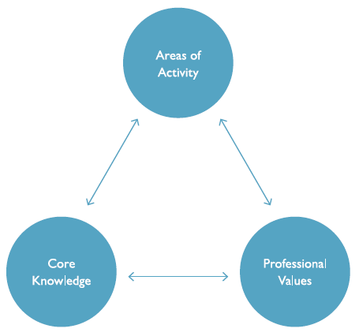
The UK Professional Standards Framework for teaching and supporting learning in higher education

Slide 19
Areas of Activity
Design and plan learning activities and/or programmes of study
Teach and/or support learning
Assess and give feedback to learners
Develop effective learning environments and approaches to student support and guidance
Engage in continuing professional development in subjects/disciplines and their pedagogy, incorporating research, scholarship and the evaluation of professional practices
Core Knowledge
The subject material
Appropriate methods for teaching, learning and assessing in the subject area and at the level of the academic programme
How students learn, both generally and within their subject/ disciplinary area(s)
The use and value of appropriate learning technologies
Methods for evaluating the effectiveness of teaching
The implications of quality assurance and quality enhancement for academic and professional practice with a particular focus on teaching
Professional Values
Respect individual learners and diverse learning communities
Promote participation in higher education and equality of opportunity for learners
Use evidence-informed approaches and the outcomes from research, scholarship and continuing professional development
Acknowledge the wider context in which higher education operates recognising the implications for professional practice

Slide 20
Excellent teaching
VIDEO CLIP

Slide 21
Rewards and recognition
“ Pedagogical competence has been considered to be the individual teacher’s concern for far too long. To improve the quality of teaching and students’ learning, teaching has to really become the concern of the entire university. We have to regard pedagogical competence just as we regard scholarly proficiency.” [Ryegård et al (Eds ) (2010). A Swedish Perspective on Pedagogical Competence]
“Institutions need to ensure there is manifest and actual parity of esteem for teaching and research in their core identity and culture and expressed in their systems of rewards, incentives, promotions and priorities.” [report to EU Commission]

Slide 22
Responses-professional development
Requirements
Induction or Orientation programmes that covers the different aspects of teaching and learning (11)
Opportunities
Staff members are encouraged to attend internal & external workshops focused on teaching and learning, assessment and curriculum (courses, seminars, training) (55)
Junior staff are attached to more experienced senior staff as part of mentoring programme (13)
Staff engage in peer learning both formally and informally focusing on topics such as pedagogy, assessment, classroom management etc. (8)
Staff members encouraged and funded to do a qualification in education (6)
Awards focused on rewarding excellence in teaching (2)

Slide 23
Academics as teachers
VIDEO CLIP

Slide 24
Professional development
“The need for professional training as a teacher at primary and secondary school level is generally taken for granted but remarkably, when it comes to higher education there seems to be an all too common assumption that such professional teacher training is not necessary, as if it is somehow an idea unworthy of the professional academic.”
[Report to the European Commission on Improving the Quality of Teaching and Learning in Europe’s Higher Education Institutions (2013).]
University teaching is one of the few professions in the world for which people need no qualifications, no experience and no knowledge. But that is changing….

Slide 25
Teaching competence
“More and more [EU] universities require proof of teaching skills from job applicants and their agreement to continuously update those skills.
[Report to the EU Commission]
In the Netherlands, for example, every academic is required to have a University Teaching Qualification.

Slide 26
GROUP DISCUSSION
Professional Development as teachers
What knowledge and skills are needed to be a good university teacher?
How are academics at your institution expected to obtain this knowledge and skills?
How can your institution improve lecturers’ teaching competence?
Summarise useful ideas and challenges discussed.

Slide 27
Pedagogical competence
In Sweden every academic must do the equivalent of 400 hours (40 credits in our system) of pedagogical training and be able to demonstrate pedagogical competence to be permanently appointed. Teaching skills are only one component.
“Pedagogical competence can be described as the ability and the will to regularly apply the attitude, knowledge and skills that promote the learning of the teacher’s students. This shall take place in accordance with the goals that are being aimed at and the existing framework and presupposes continuous development of the teacher’s own competence and course design.” (Uppsala University)

Slide 28
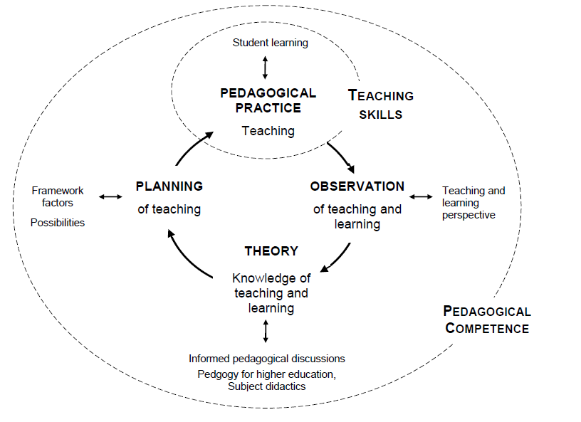
Model for pedagogical competence
Olsson and Toxa (2013). European Journal of Higher Education, 3 (1), 40-61.

Slide 29
Innovative teaching for the future
[VIDEO CLIP]

Slide 30
We look forward to a time when the new ideas on models of learning, on interdisciplinarity, integrated learning, on team pedagogy, on deep teaming etc. will be mainstreamed, inspiring a new generation of students to reach levels of intellectual literacy that stretch them beyond merely 'good enough' to 'excellent.
…while [removing] many barriers to the full professionalization of higher education teachers is some way off, it is a goal worth setting and a destination which is our best chance of achieving excellence in teaching across the EU's higher education sector. It is also an important vehicle for ironing out the vast disparities in educational outcomes which are not the best use of the resource that is the brainpower of our people. It also makes the profession of higher education teacher an exciting one, more fufilling, dynamically self-interrogating, and therefore self-updating and useful. It has the capacity to shift the learning environment into a very different and much more attractive kilter. [report to EU commission]

